Slide 1
How to take risks without getting clawed in the face
Thomas Rayner
Sr. Security Service Engineer
Microsoft
🐺

Slide 2

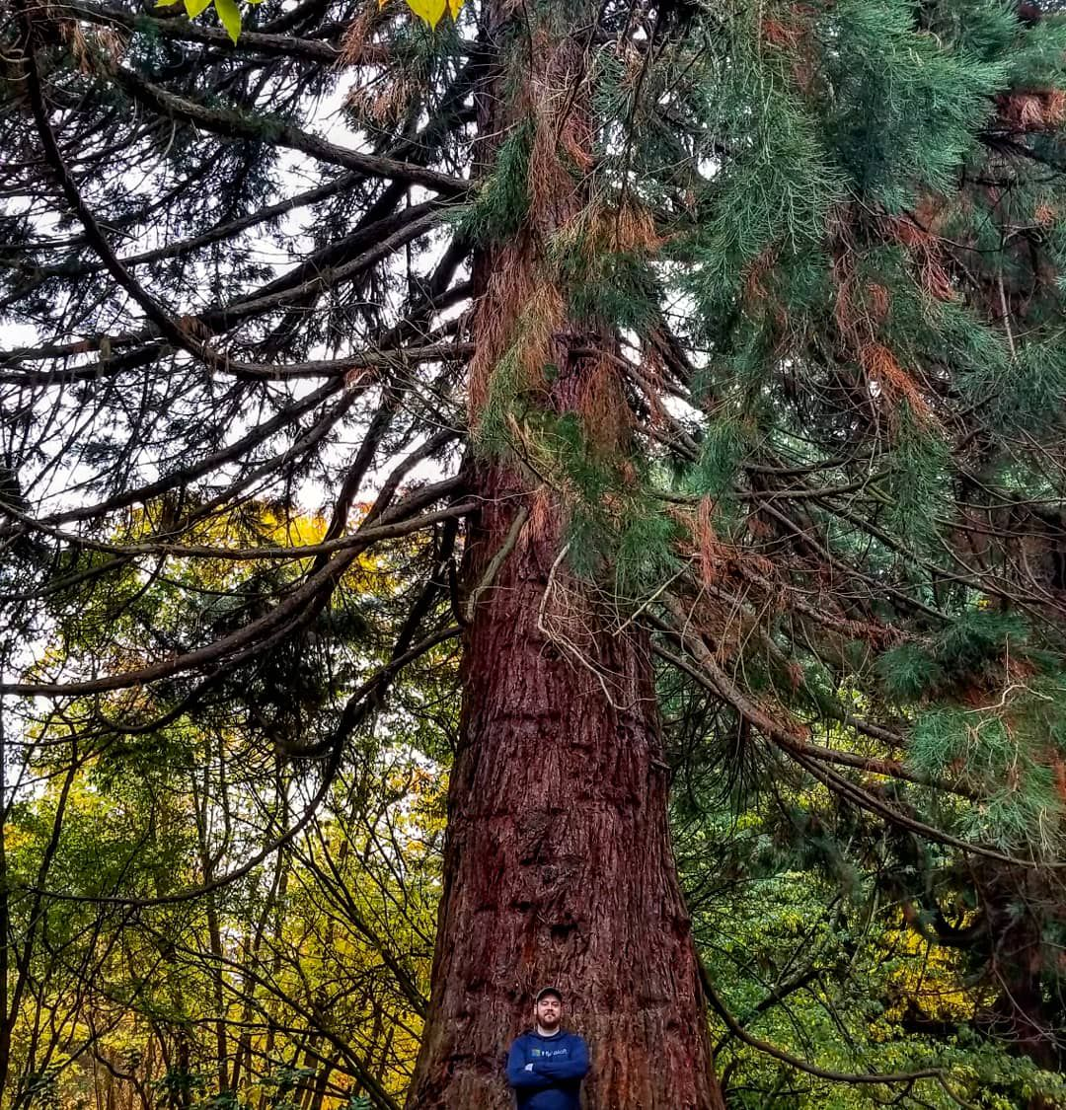

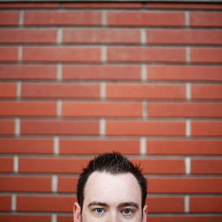
Obligatory Bio Slide
I work at Microsoft on a pretty cool team
I used to work at some other cool places doing cool things, used to be an MVP
You can find me all over the place
@MrThomasRayner
thomasrayner.ca
github.com/thomasrayner
PowerShell Discord/Slack
Join: j.mp/psdiscord or j.mp/psslack
pluralsight.com/authors/thomas-rayner
Master PowerShell Tricks books
🐺

Slide 3
Story Time
🐺

Slide 4
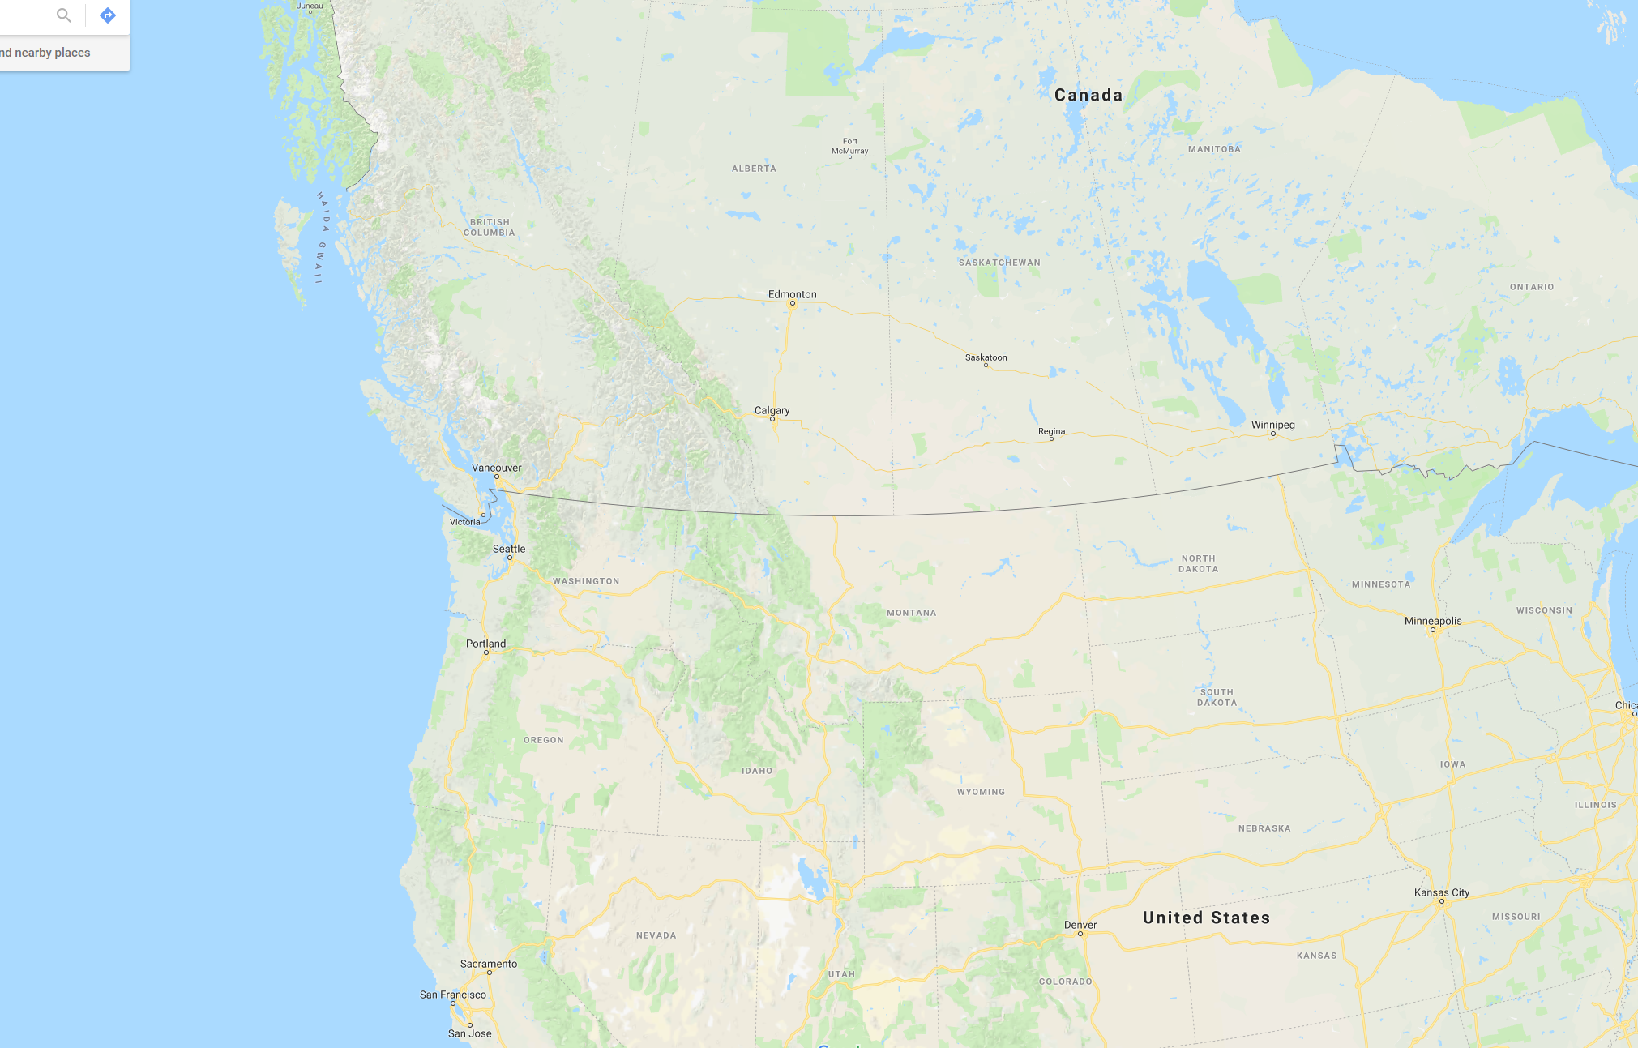
Edmonton, AB
Redmond, WA
Notes:
We are here in Redmond
I am from Edmonton originally, where I lived at the time of this story

Slide 5
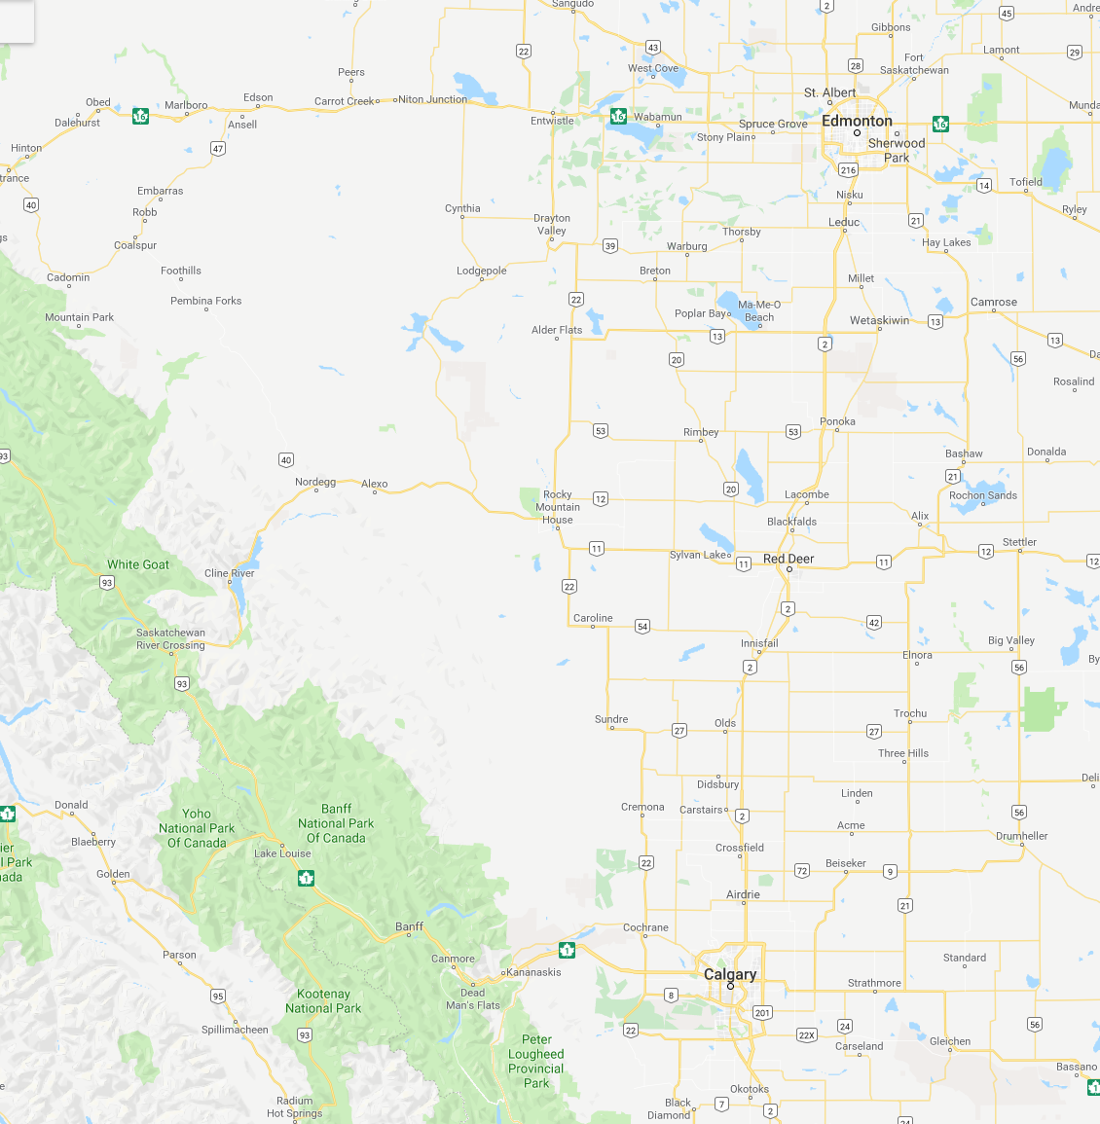
Home
Banff
Notes:
About 4.5 hour drive south west of Edmonton is Banff
We love Banff, it’s gorgeous

Slide 6
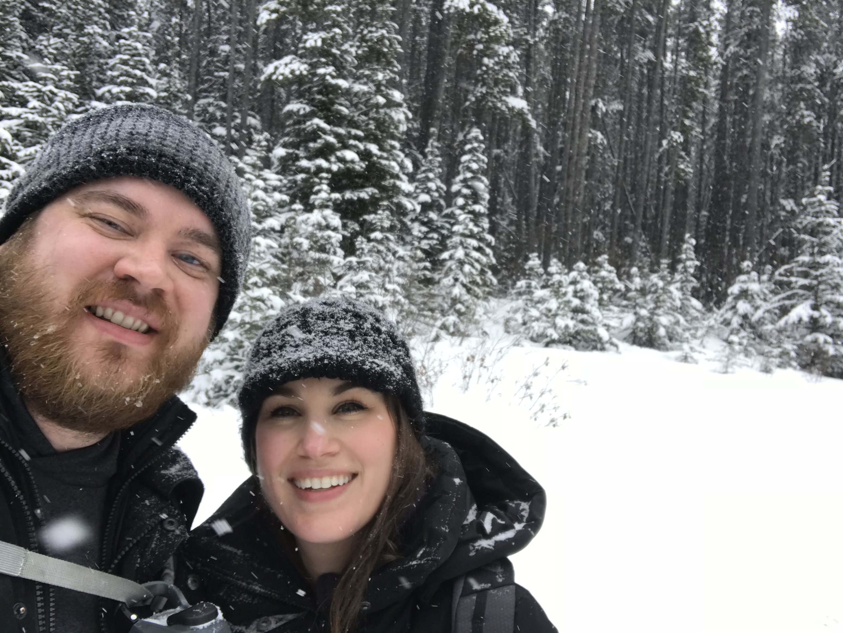
Notes:
We hiked
I got snow in my eye
Looks like nice weather, eh?

Slide 7
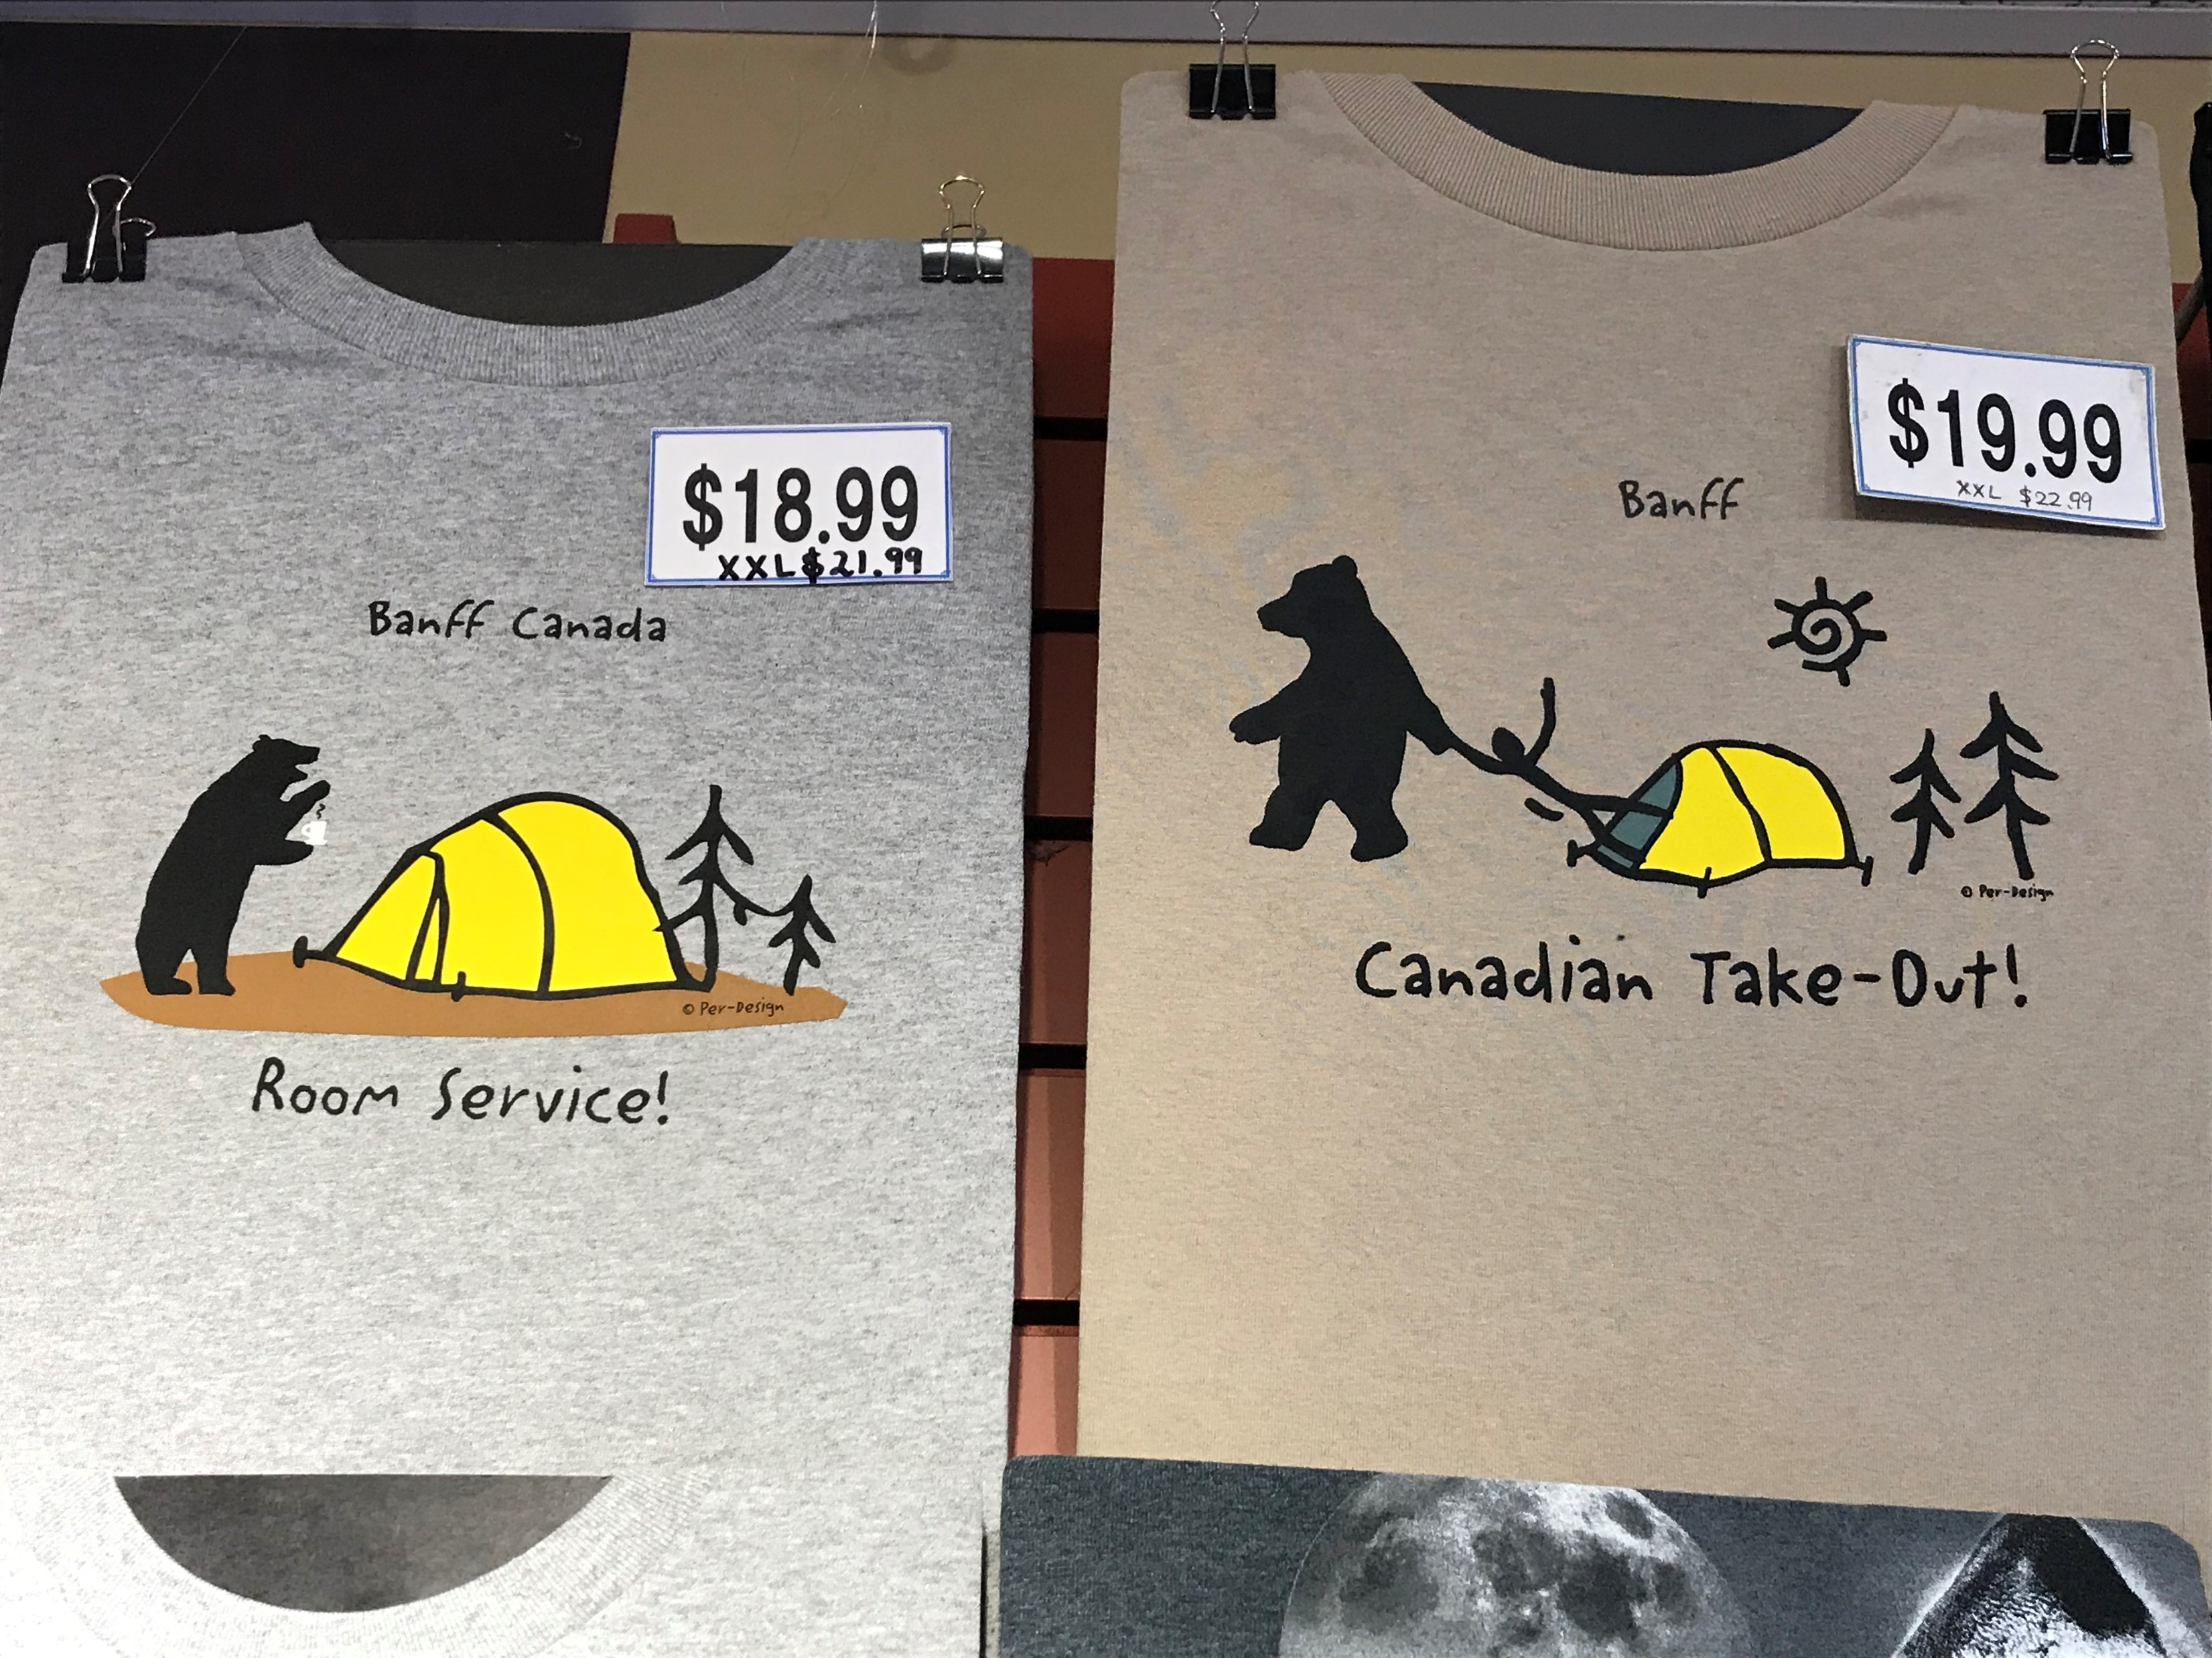
Notes:
We visited some local shops selling goods from the area

Slide 8
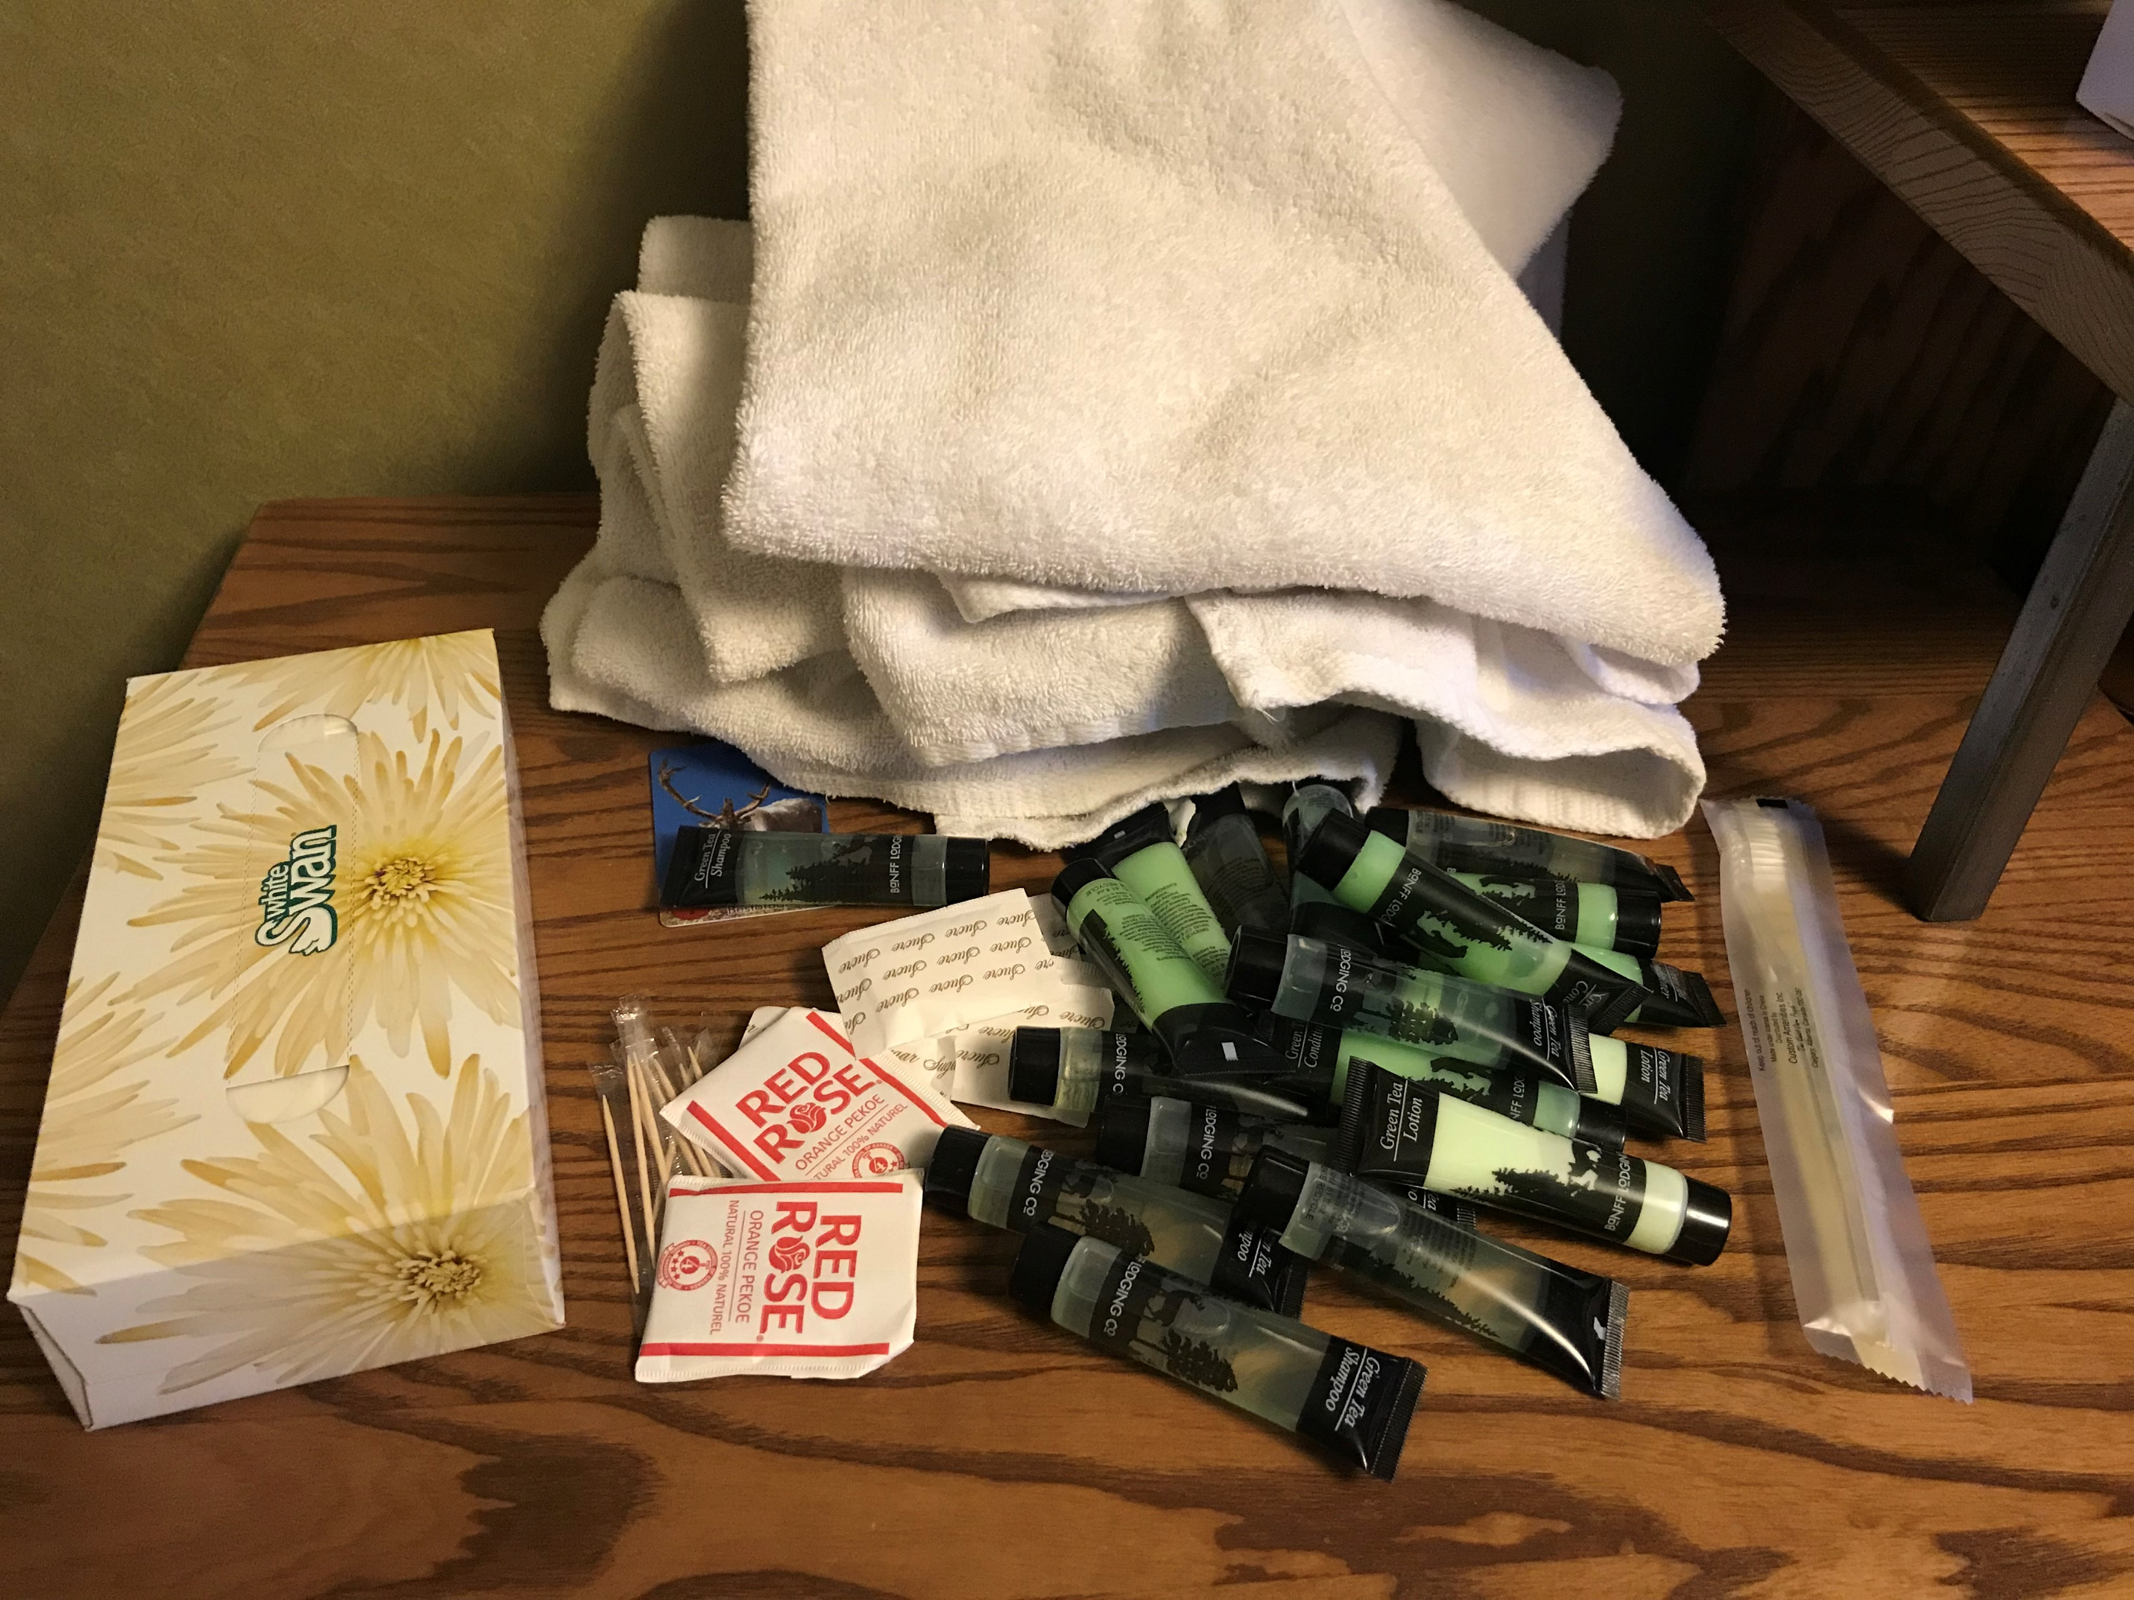
Notes:
We stayed at a really nice hotel
This place was super rustic, but gorgeous and comfortable at the same time
There was an unattended housekeeping cart

Slide 9
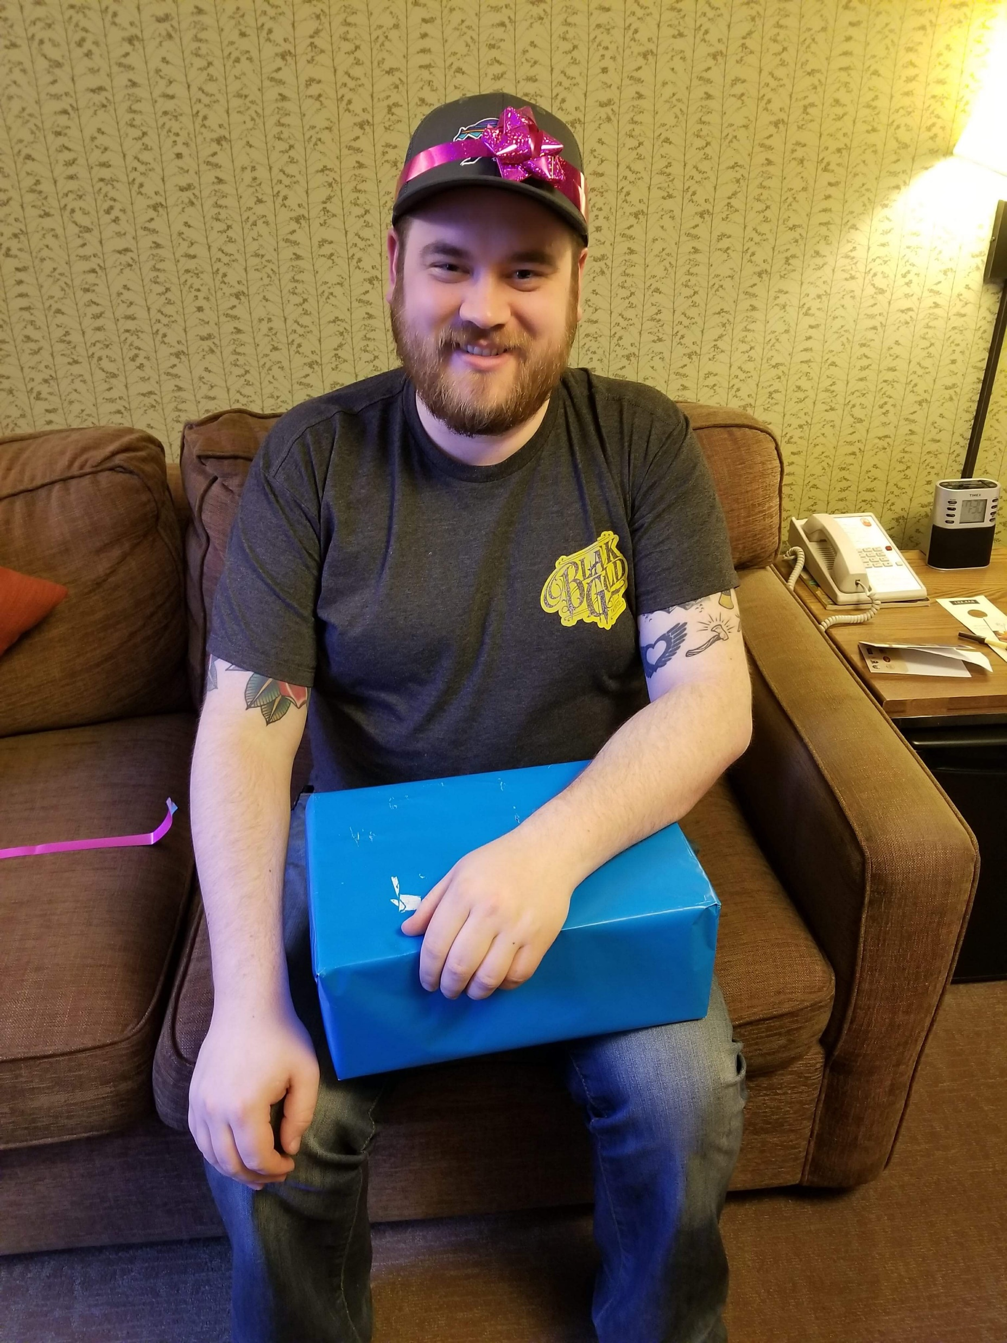
Notes:
Remember how it was my birthday?
I opened a couple gifts and got the coolest surprise ever

Slide 10
Home
Golden
Banff
Notes:
Let’s look at the map again for a second
A little further west of Banff, is a small town in BC called Golden
What is there in Golden?
Skiing, hiking, tours…
And…

Slide 11
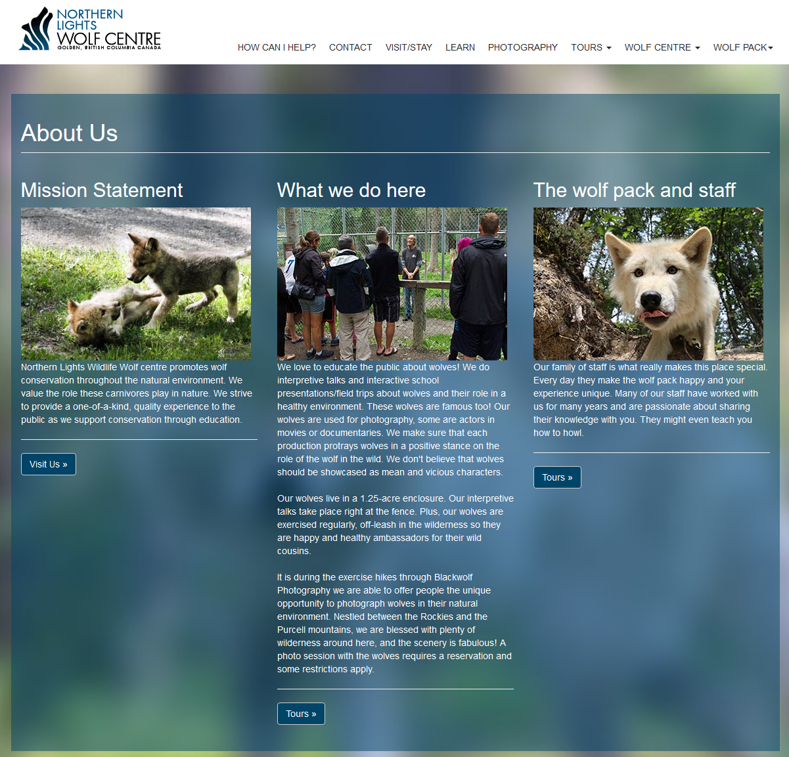
Notes:
The Northern Lights Wolf Centre!!!
This place is incredible
Rescue wolves from bad situations
Wolves that can’t go back into the wild
Interpretive center
Real. F-ing. Wolves.

Slide 12
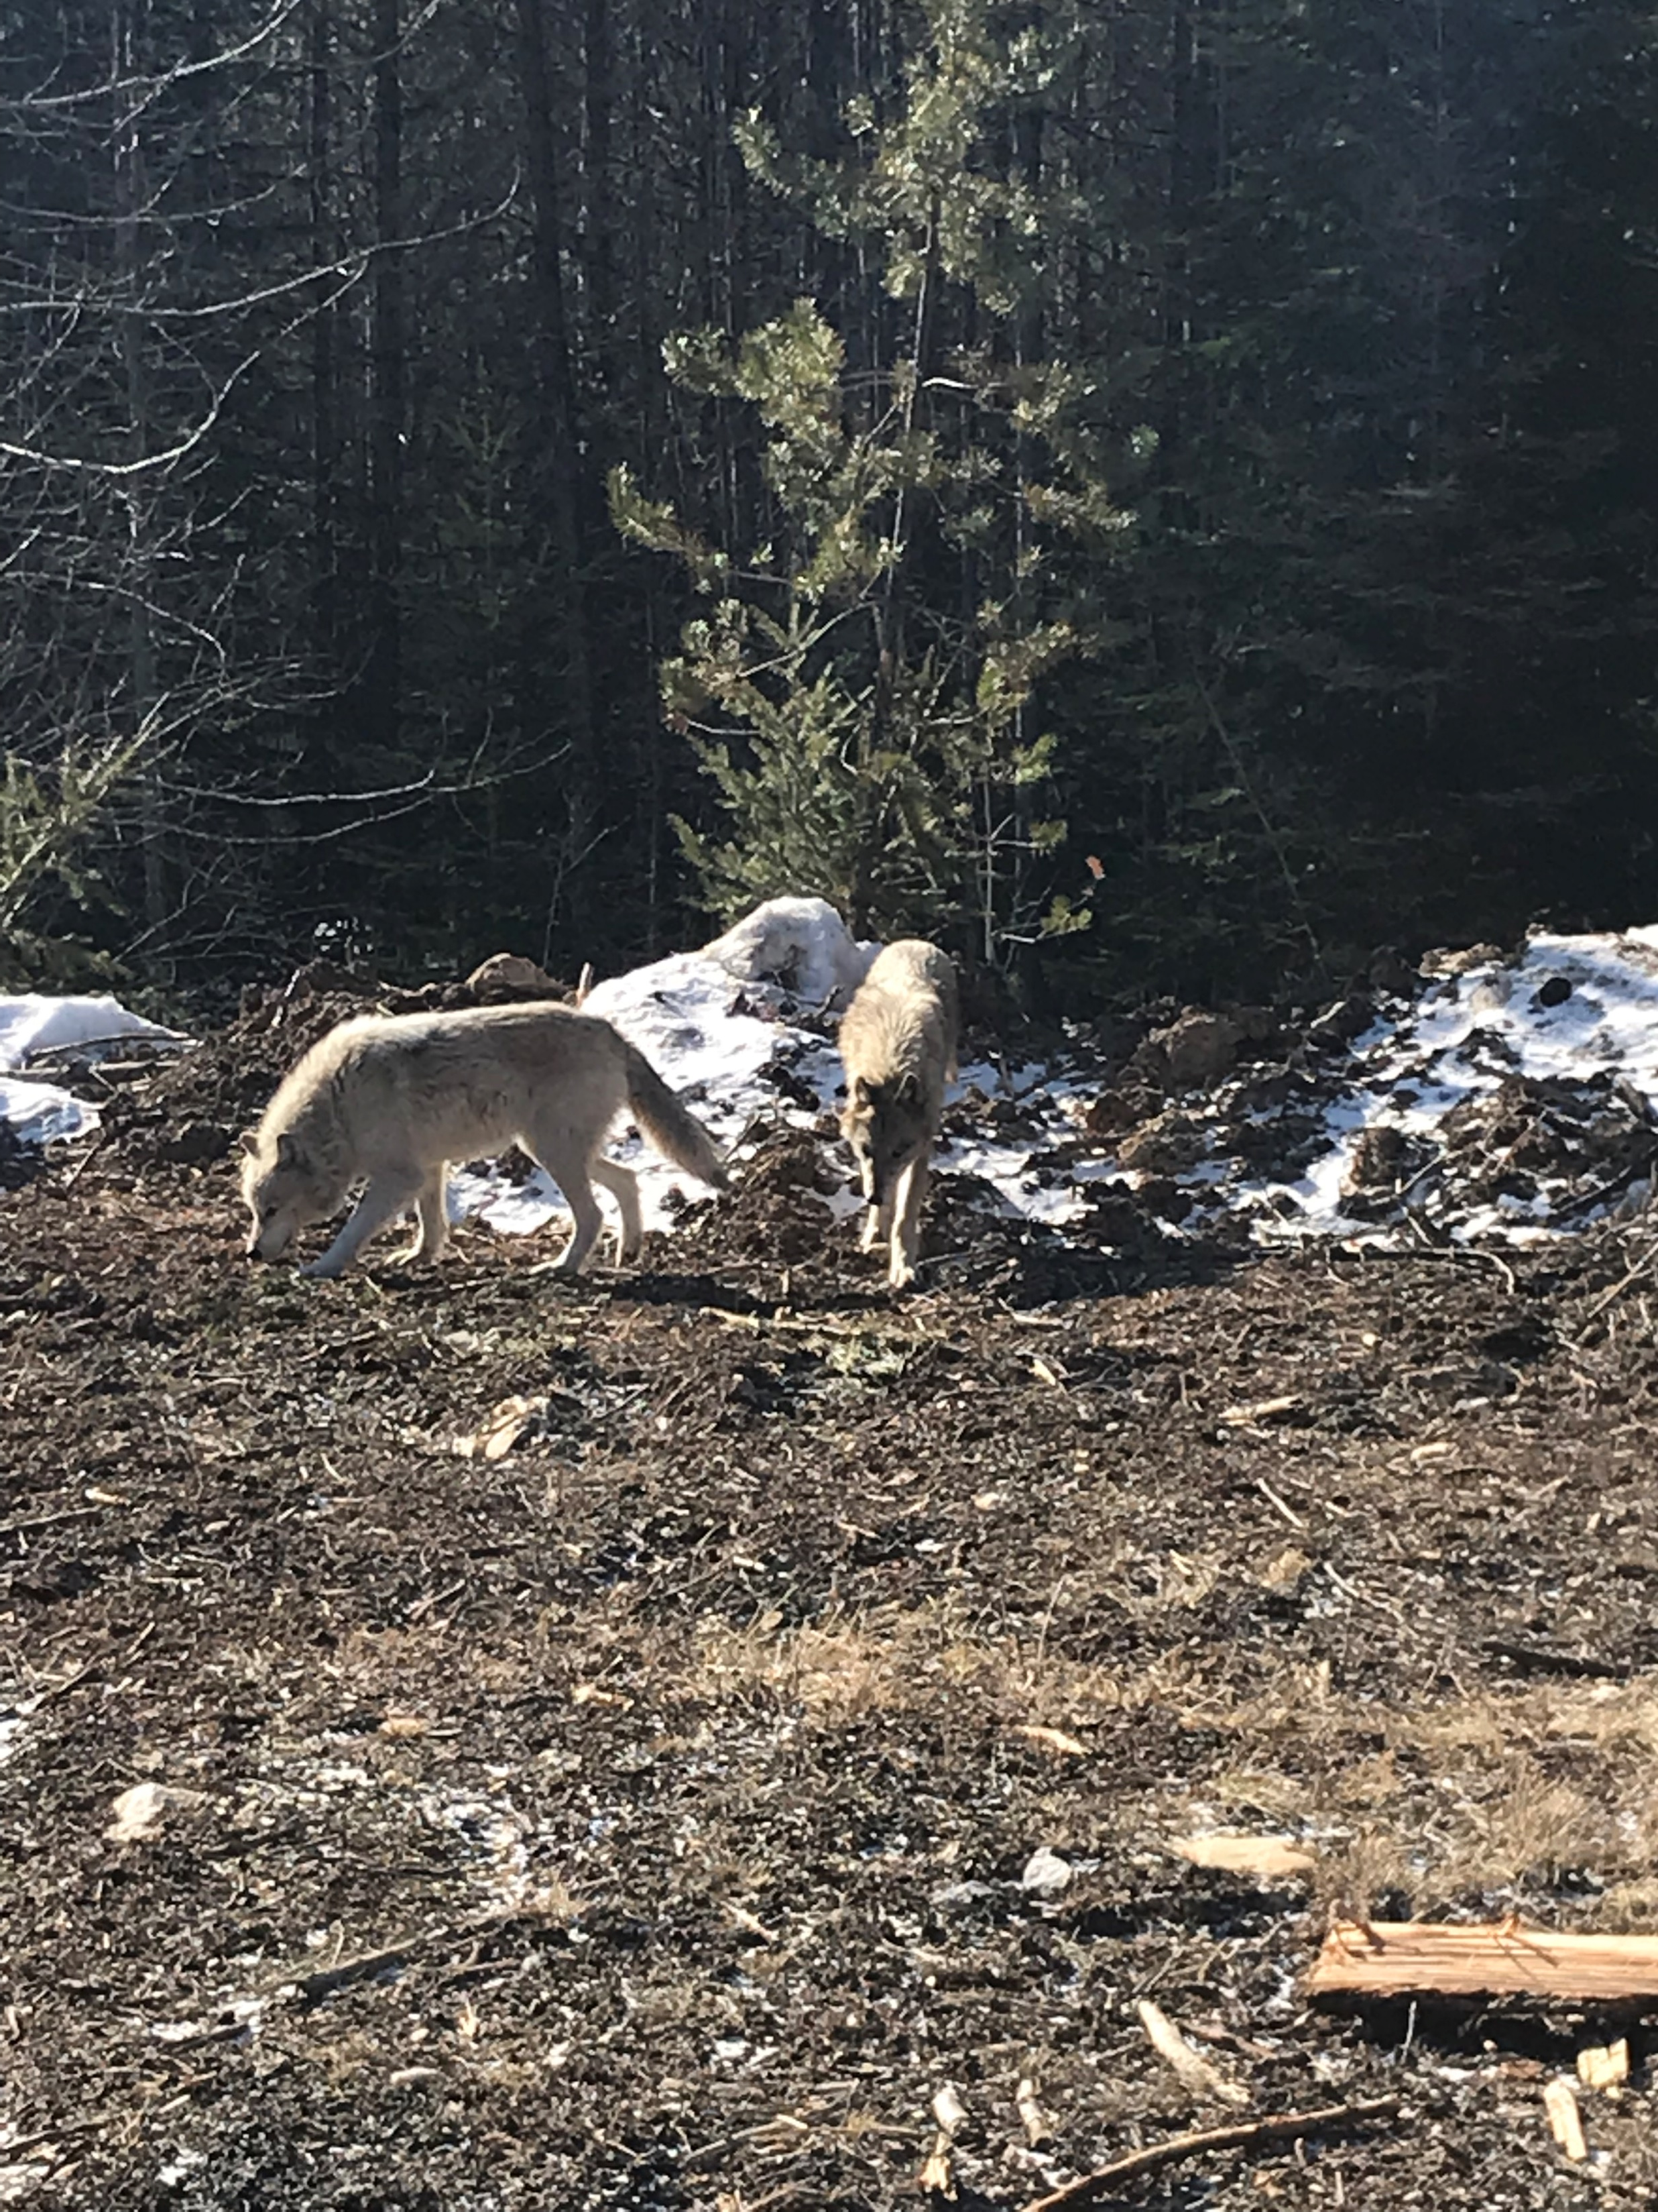
Flora
Uno
Notes:
These are real, not fooling around, actual wolves
You go for a little hike with them
The interpreters are in control
The wolves run around, dart in and out of your small group
It’s surreal
They are not dogs
By the way, these are two of the smaller ones
A female and a younger male
Flora and Uno
Can you guess why he’s named Uno?

Slide 13
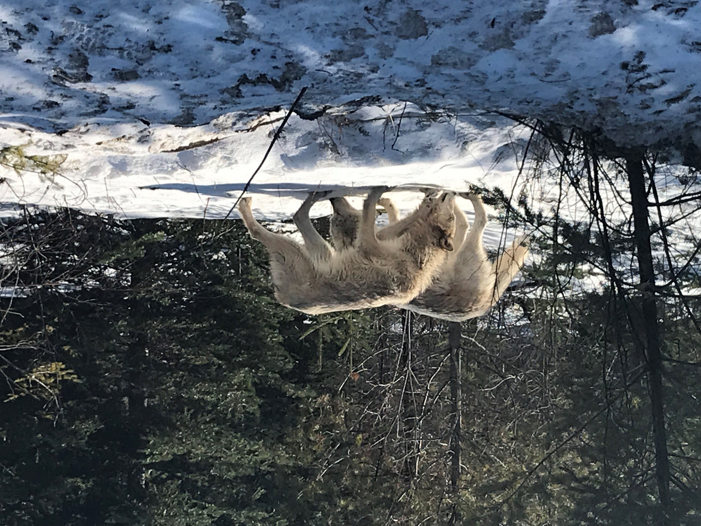
Notes:
Before you go, you sign some waivers releasing rights to photos
Includes language about “these are wild wolves, although they’ve been imprinted on humans, this isn’t like visiting your friend’s labradoodle. These are wolves, and wolves can be dangerous and unpredictable”
The guides are amazing – knowledgeable, informative, and this is a tourist attraction, so you feel pretty safe
We understood and accepted the risks before we embarked on our walk

Slide 14
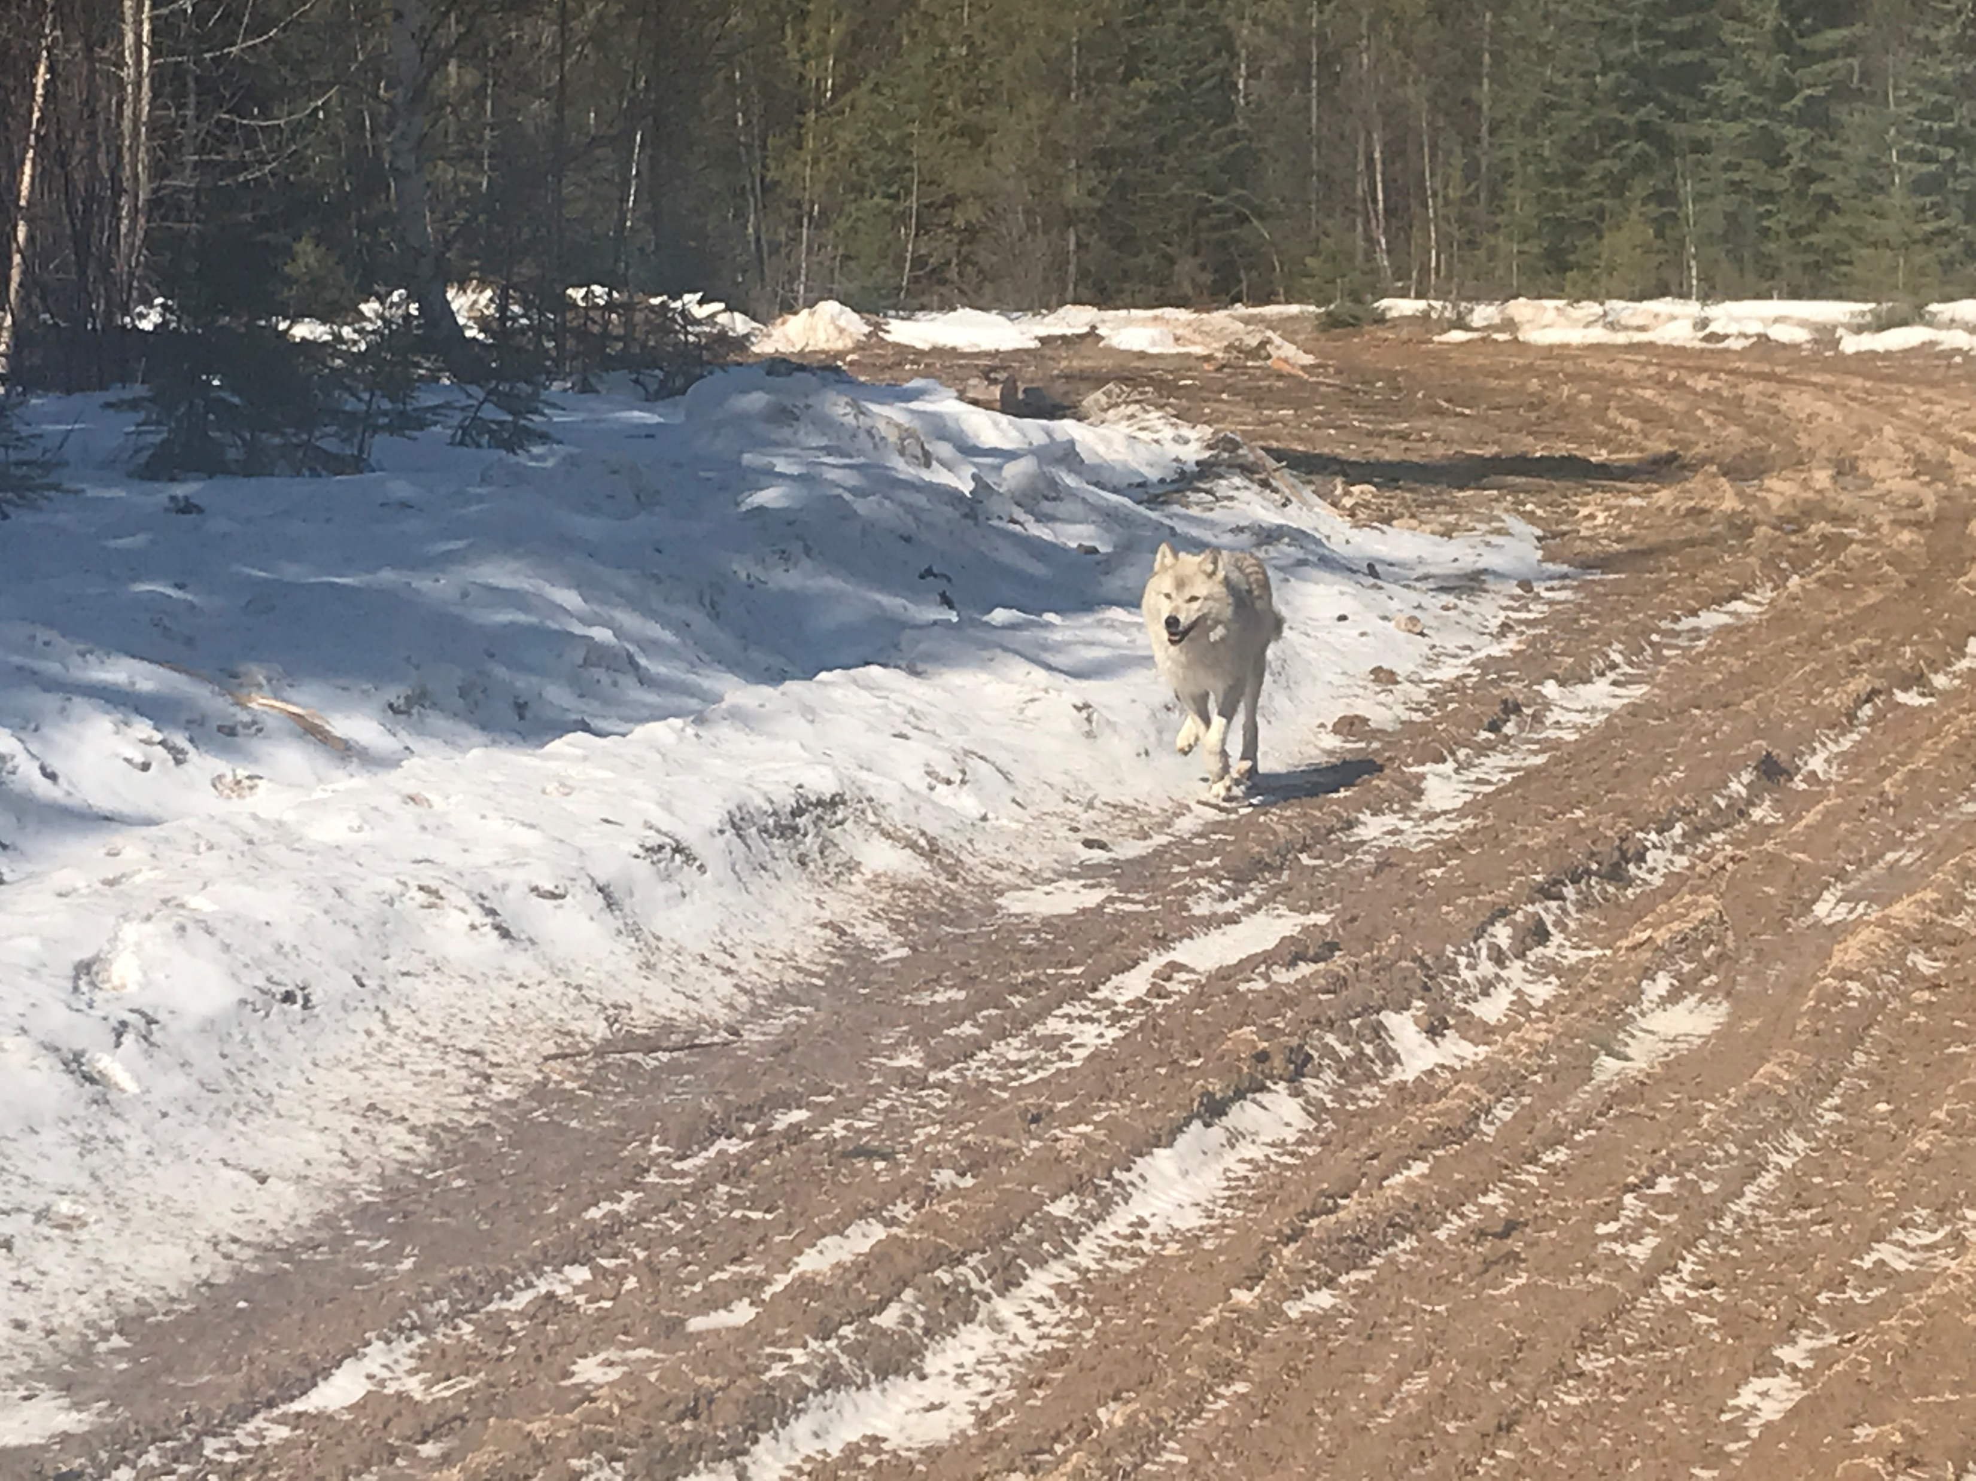
Notes:
They’re fast and nimble as heck
We had enough trouble on this little logging road
Wolves are obviously built for this and much more
Super impressive animals, humbling

Slide 15
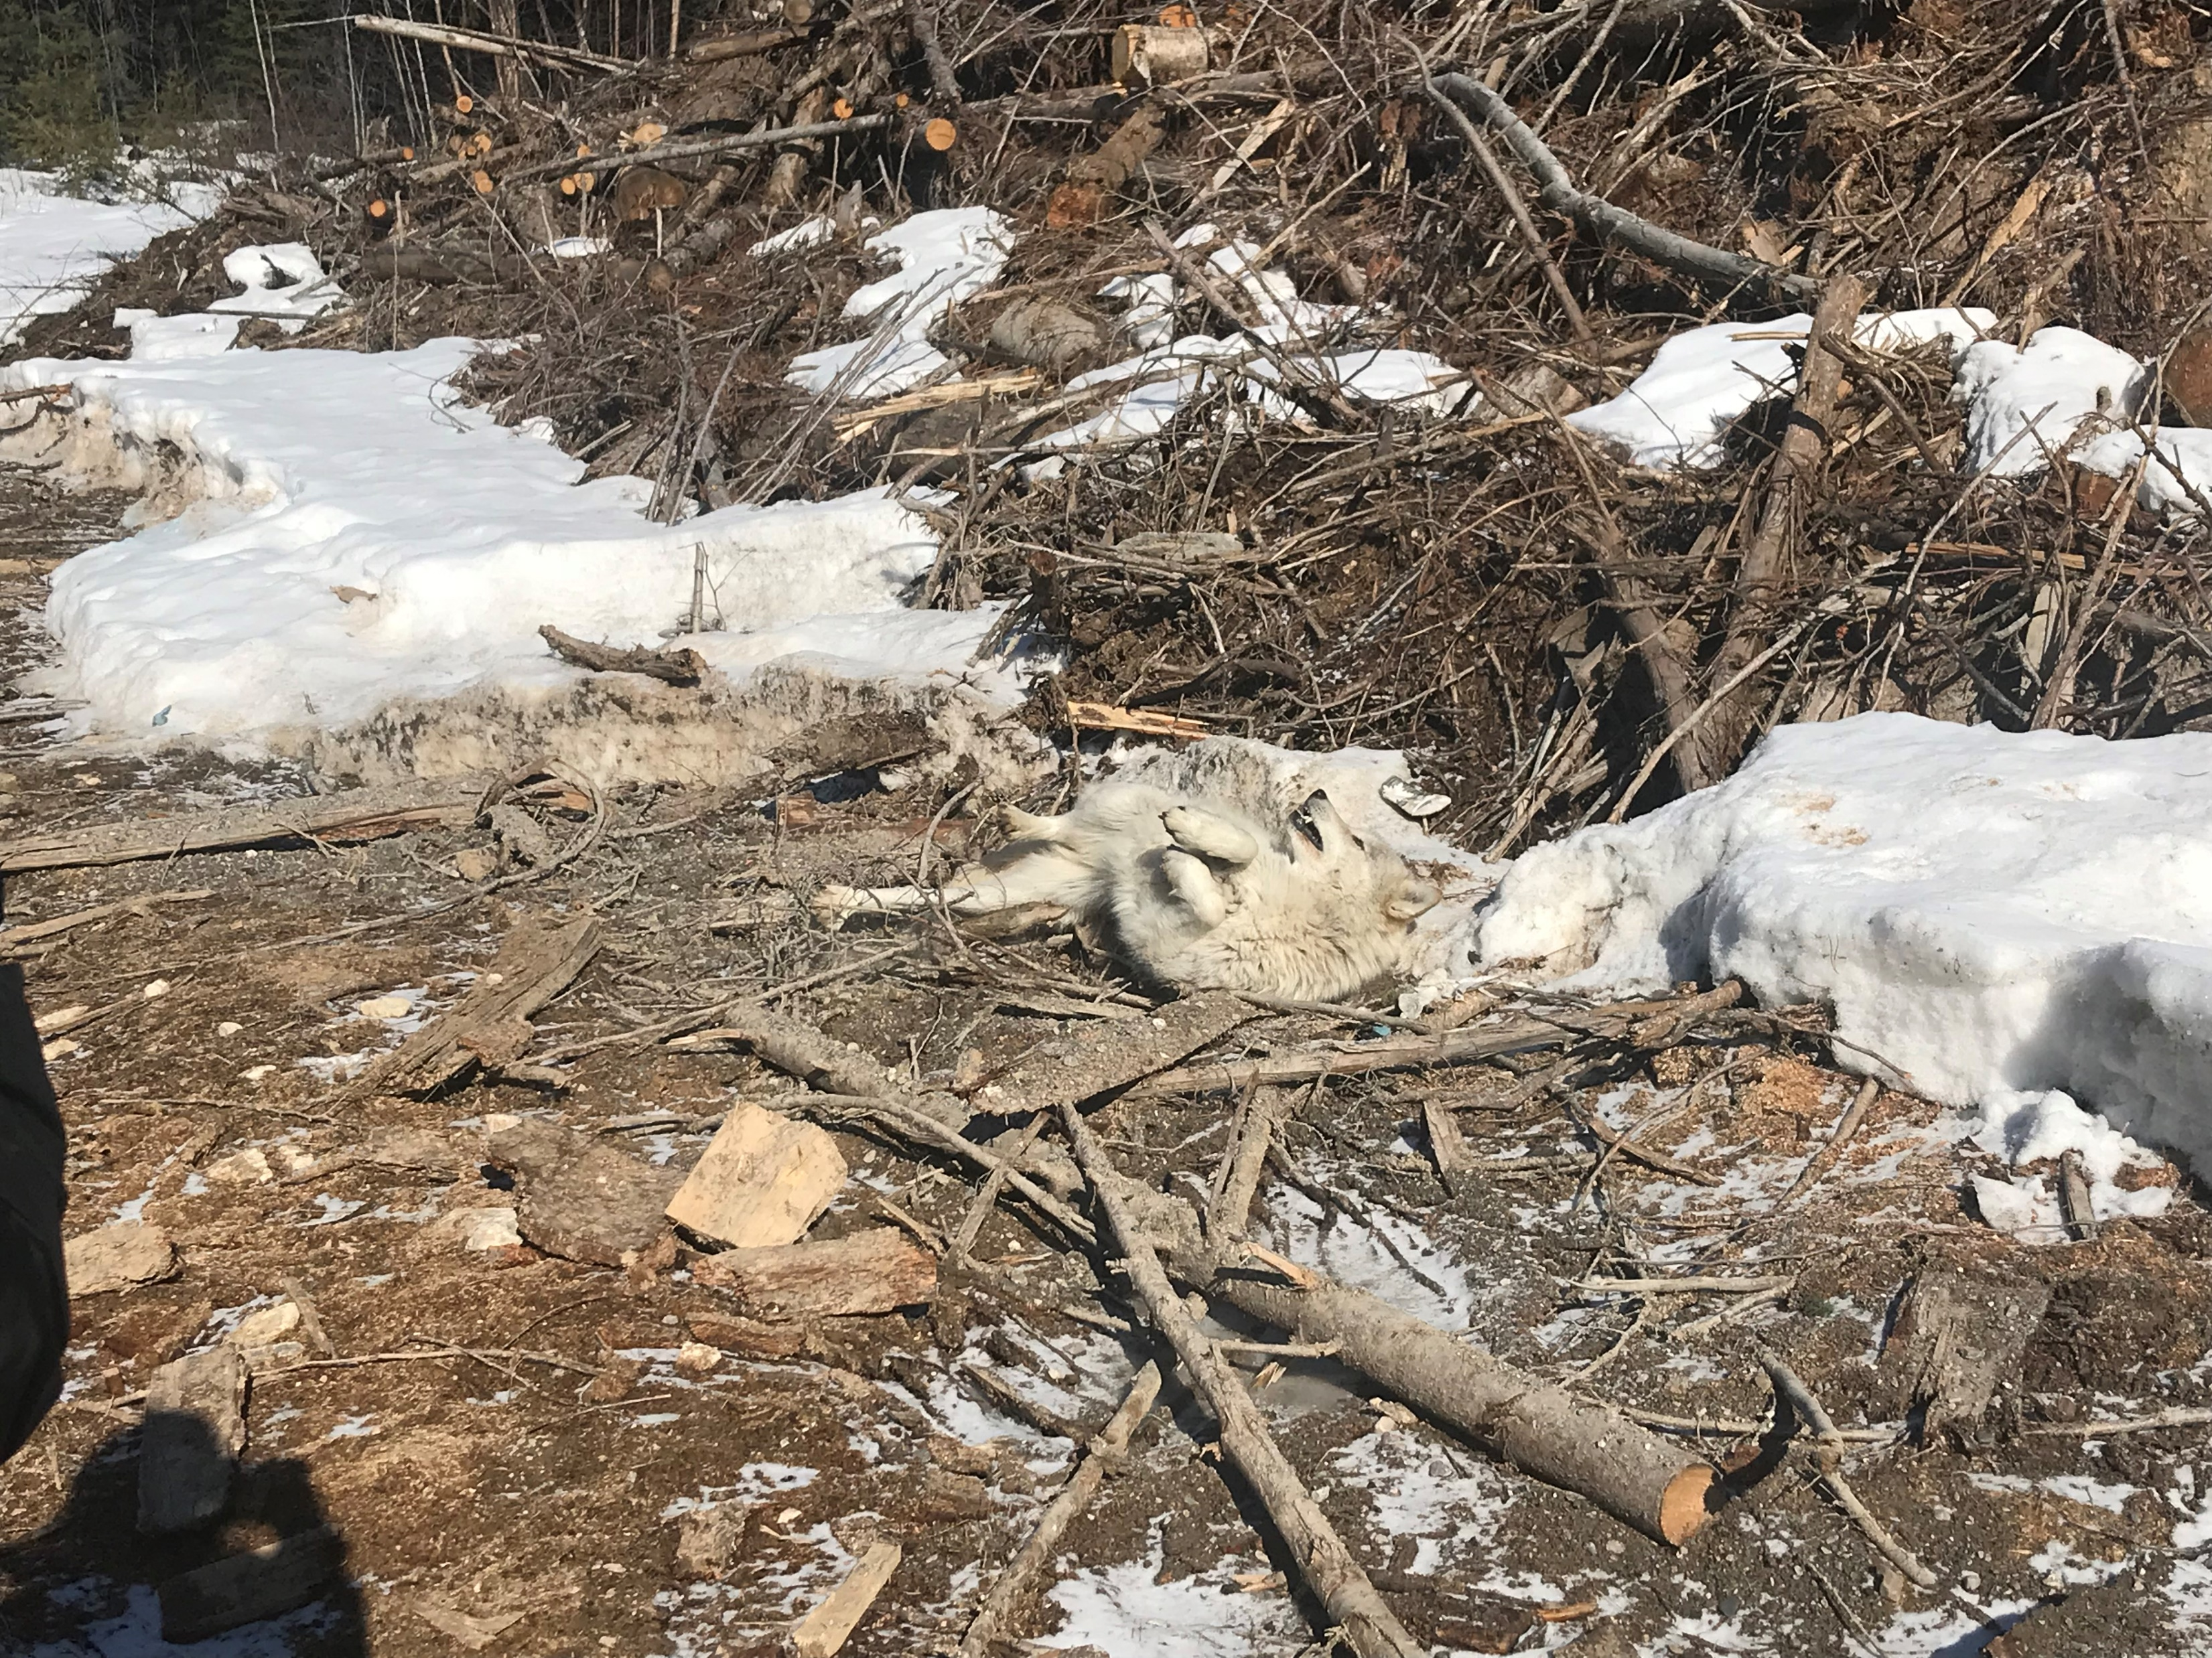
Notes:
You can kind of see some dog like behavior in them
They’re happy, they play, they roll around in gross stuff that smells interesting

Slide 16
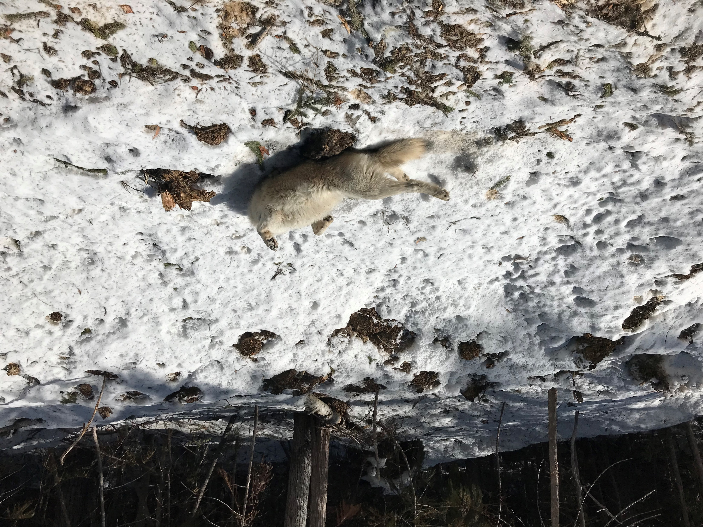
Notes:
They really like rolling around in the snow
This is NOT an invitation to pet a tummy

Slide 17
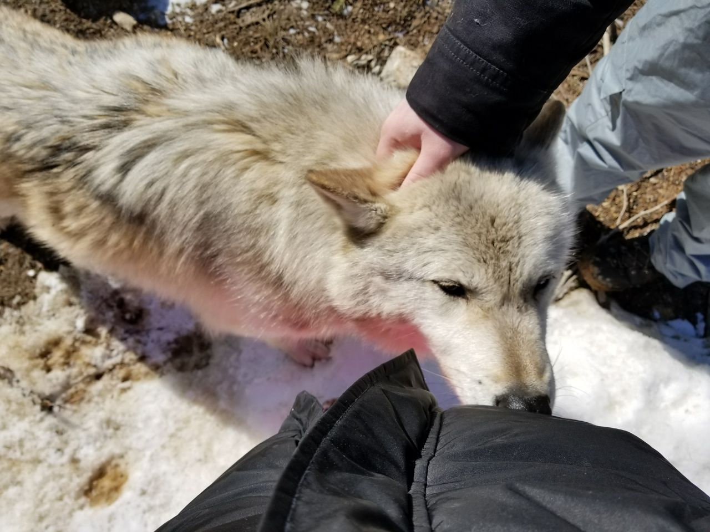
Notes:
If they like you, they’ll come up and pause near you, and you can pet them like we are here
They don’t stay long, just for a couple scritches and then they’re gone
Always moving
Fur is so coarse

Slide 18
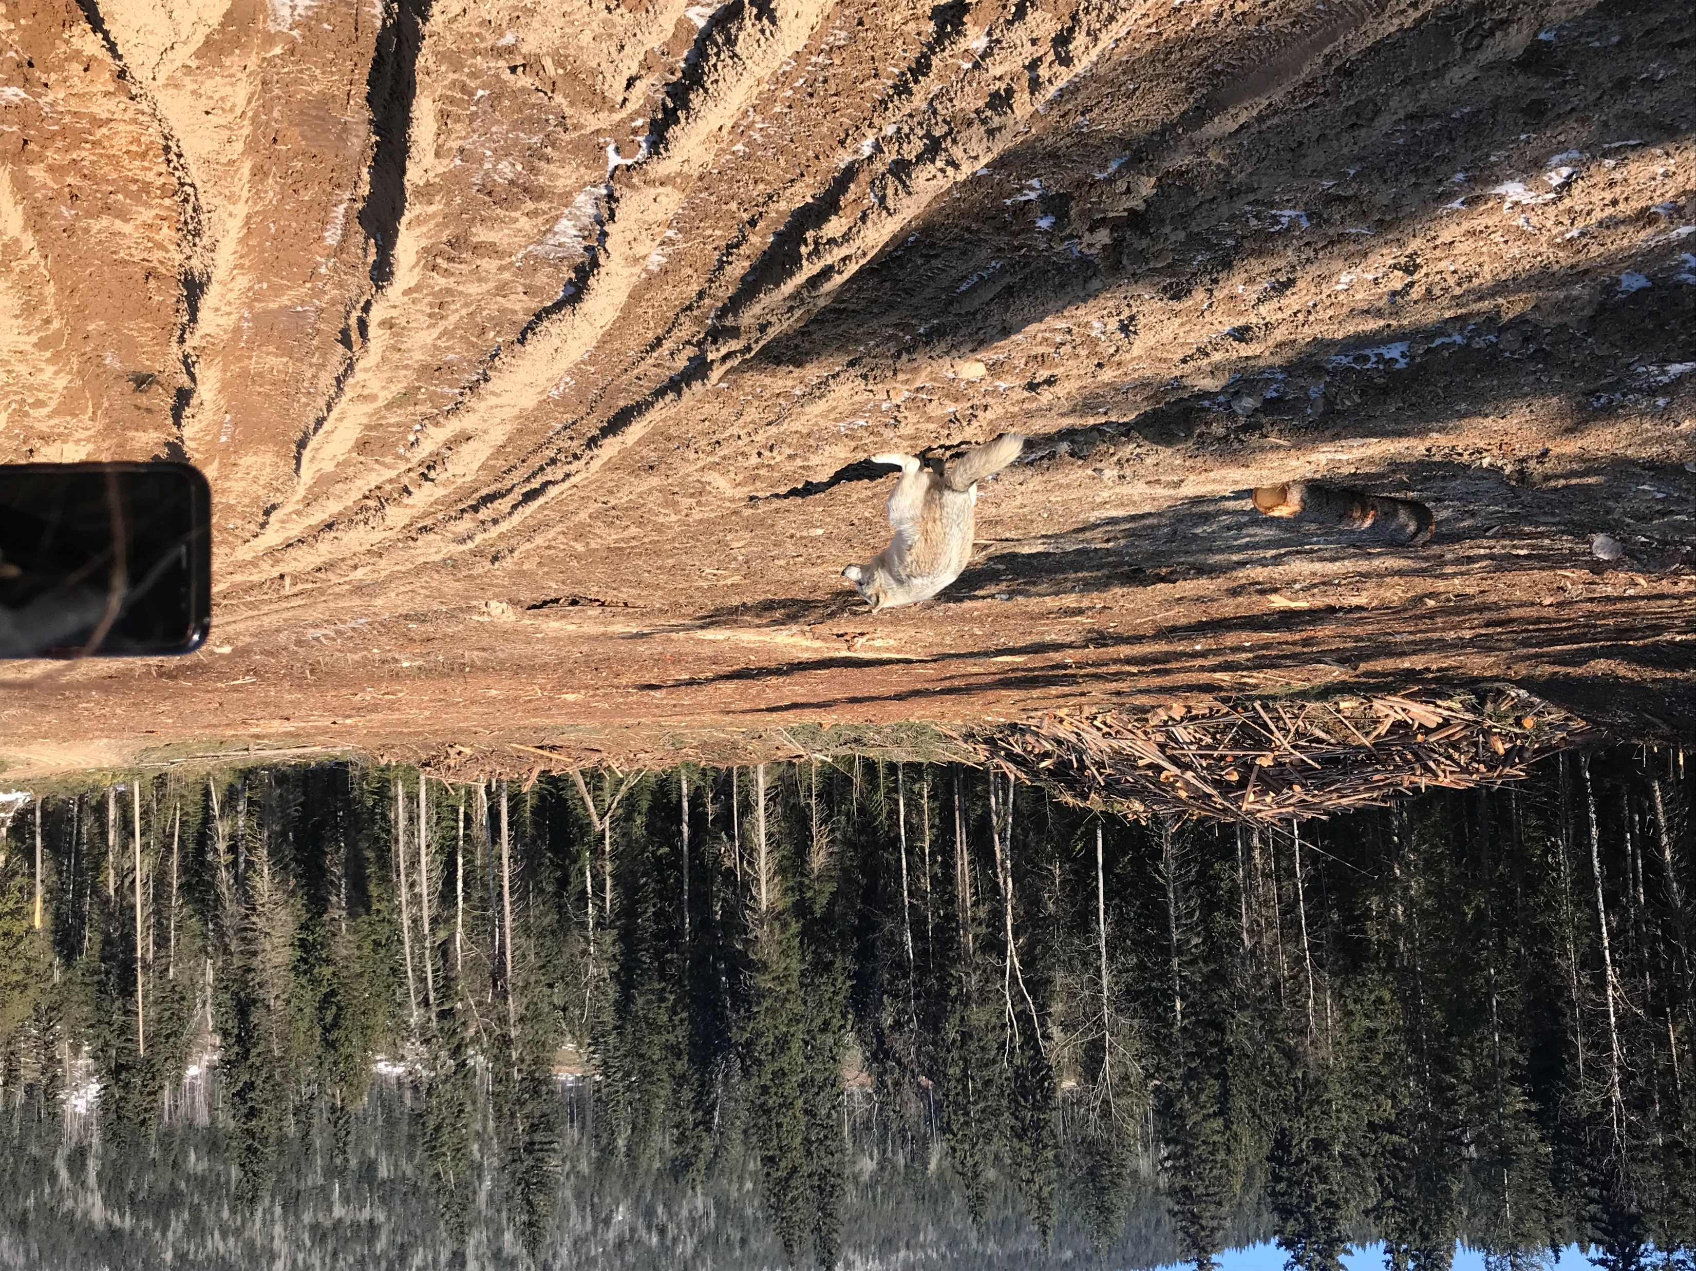
Notes:
This one doesn’t have anything to do with the story, I just thought you’d like it
Yes the wolf is pooping

Slide 19
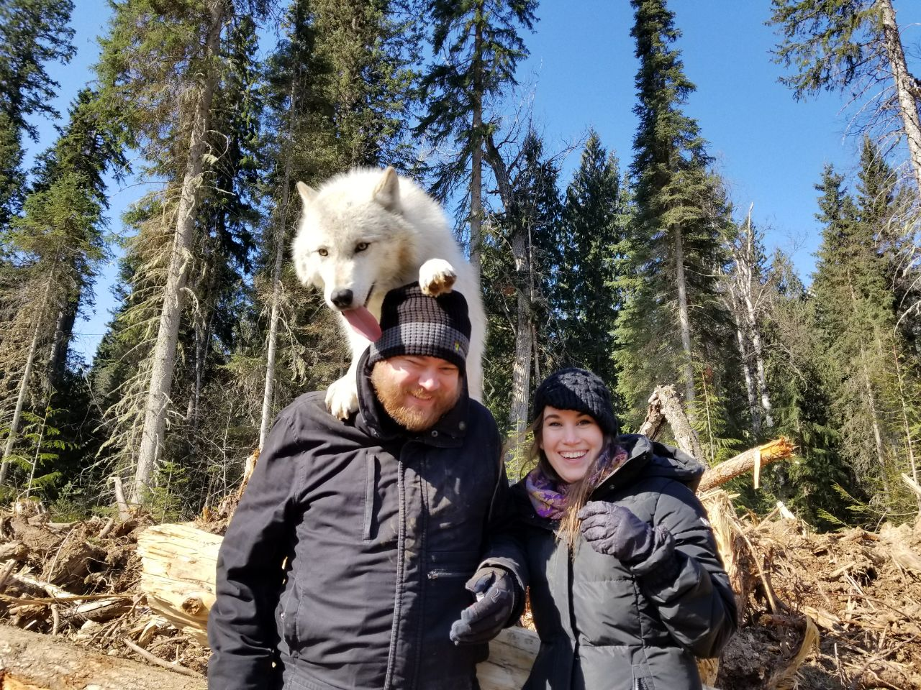
Notes:
Eventually, the guides find a spot where you can take a picture with the wolves
They toss treats, the wolves aren’t trained, but they know if they get close to the guests, they get treats
This is VERY exciting for them
They love treats
A lot
You don’t have to do it if you’re scared, but we were feeling pretty comfortable by this point
This is a photo of one of the coolest moments of my life so far
This is an amazing gift from my wife, I’ll always treasure this memory and this experience
We got a lot of cool photos here, but then something happened
Remember how wolves can be a little unpredictable?
In all the excitement, the wolf’s paw slipped off the side of my head and then her paw slipped

Slide 20
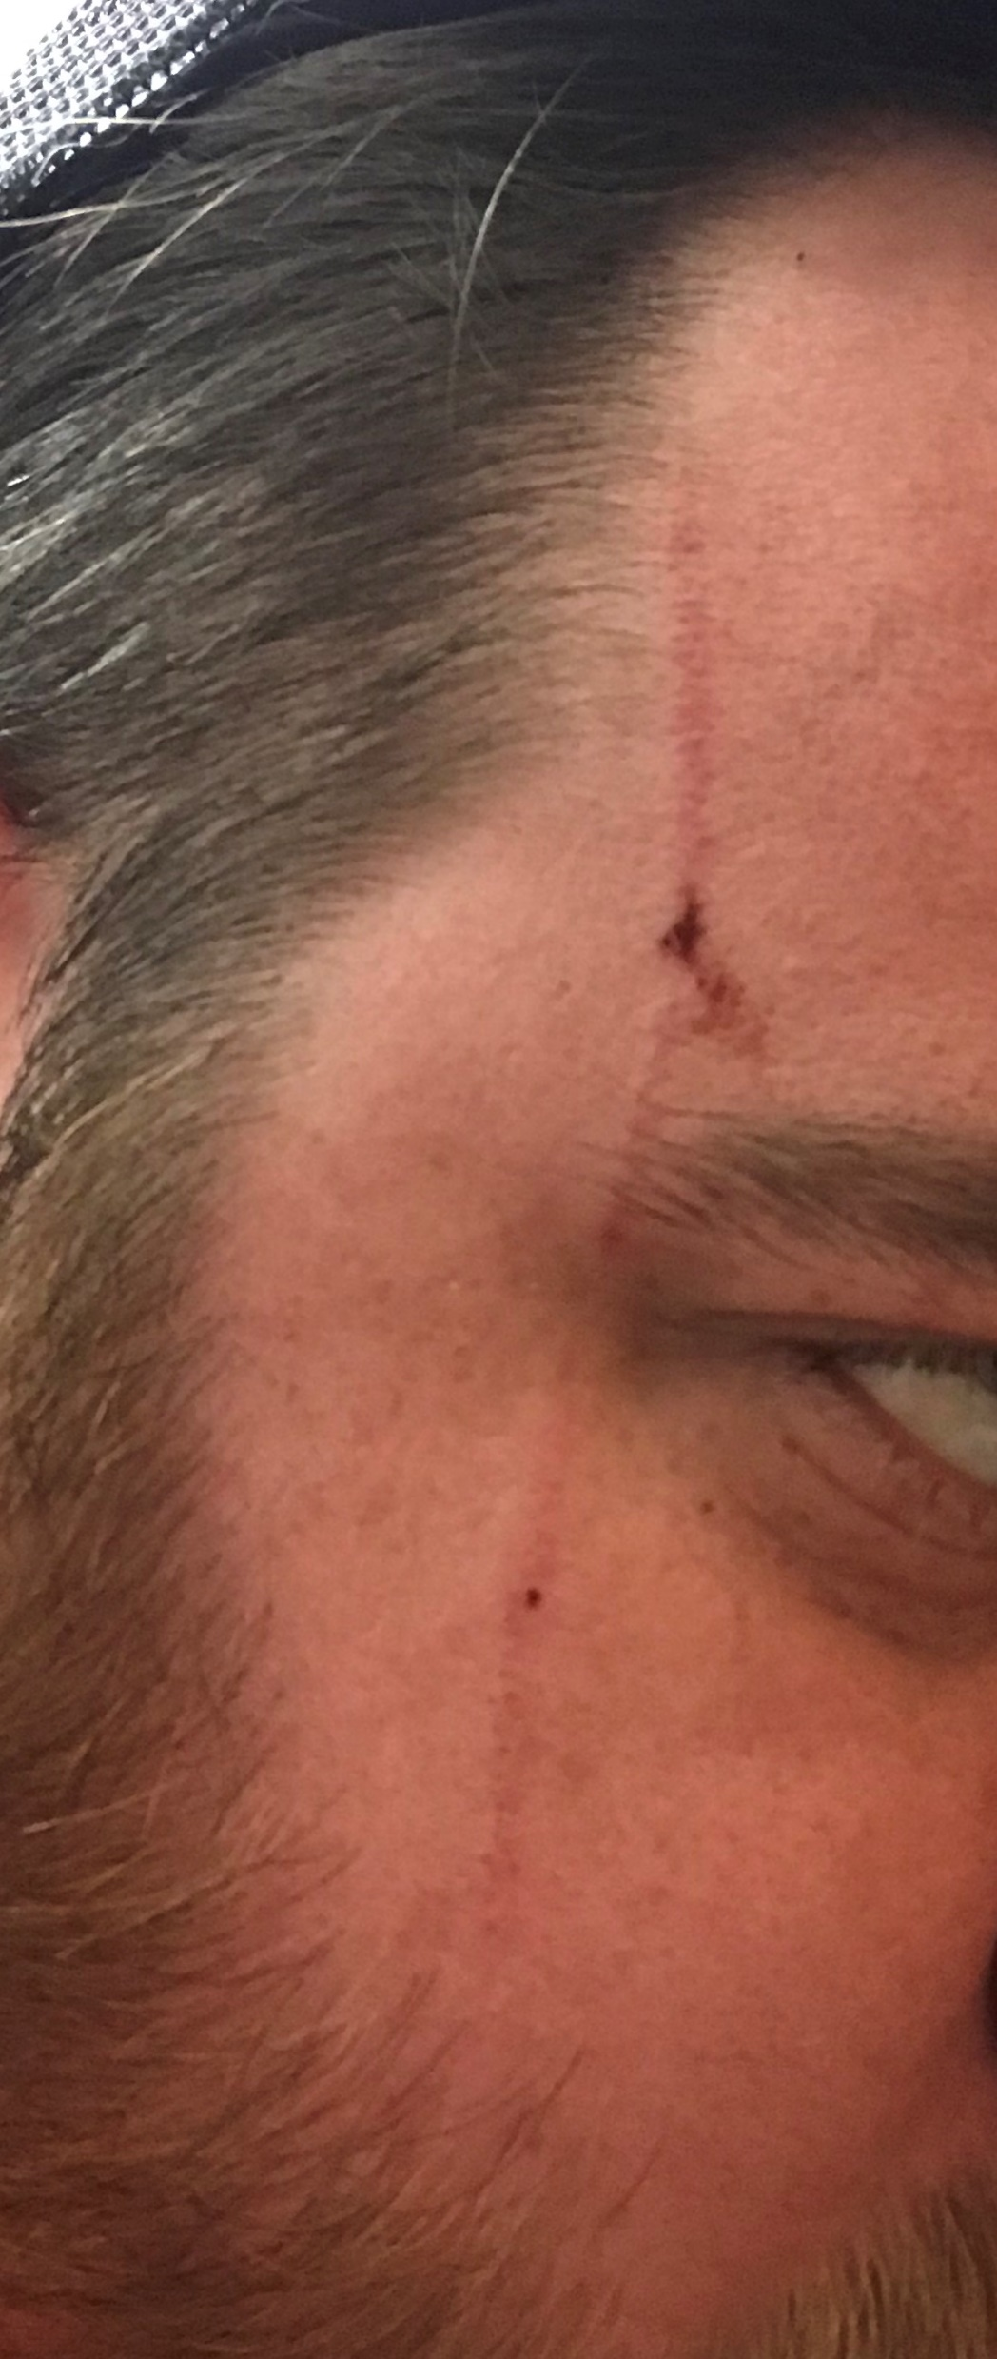
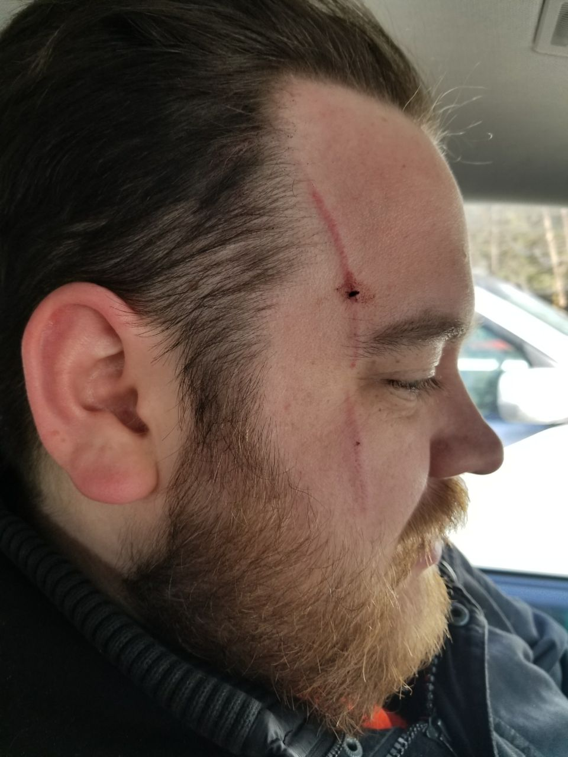
Notes:
Ouch

Slide 21
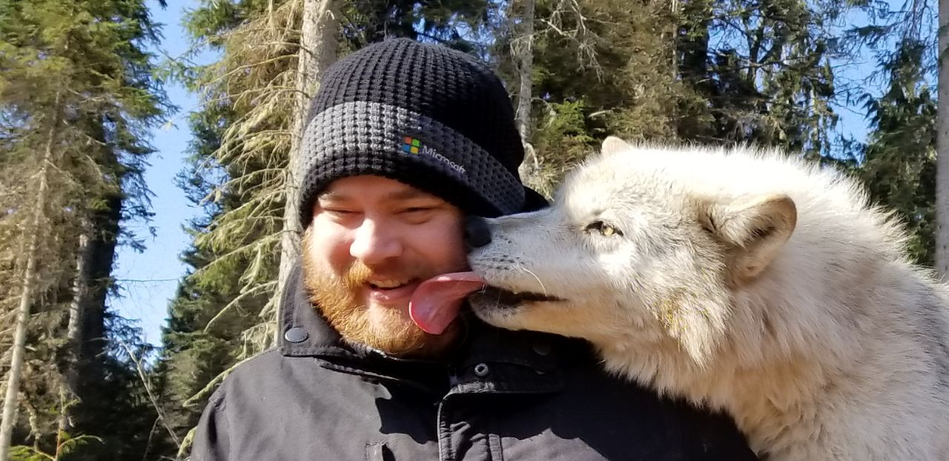
Notes:
That sucked, but look at what I still came away with
This was a once in a lifetime opportunity
Even though one of the risks I was taking was actually realized, this was one of the coolest experiences I’ve ever had and I’ll always treasure the memory

Slide 22
Cool story bro
🐺
What does this have to do with risk management?

Slide 23

Why take a risk
All investments are risks
If you don’t play, you can’t win
Complacency is death
Learning opportunities

Slide 24

Every organization has some appetite for risk.
Just because you or your boss or your advisors or your coworkers don’t know what it is, doesn’t mean it isn’t there.
Maybe they need help defining it.
Notes:
My personal appetite for risk is pretty low. It takes a lot to get me to take a substantial risk.

Slide 25
Our goals
Identify assets and their values
Identify vulnerabilities and their threats
Quantify the likelihood and business impact of threats
Provide an economic balance between impact of threat and cost of countermeasure
1
2
3
4
Notes:
Putting numbers on things is super important. How often do you get “that’s too risky” or “I can’t get that approved” just based off a simple description? Use math to prove it’s worth it.

Slide 26
Let’s talk about risk
Asset
resource, process, product or system that has value and needs protection
Threat
any circumstance that could have an adverse impact on an asset
Vulnerability
the absence or weakness of a safeguard of an asset that makes a threat more likely to occur
Control
something you do to mitigate risks
Notes:
Threat
Getting clawed in the face
We get hacked
Vulnerability
I’m a squishy human
Systems are out of date, behind on patching
Asset
My gorgeous face
Your customer data
Control
Don’t put your face near a wolf’s claws
Patch your systems

Slide 27


The value of assets
What’s the appropriate level of security for an asset?
Inaccurately valuing assets causes:
Poorly chosen controls
Cost ineffective controls
Protecting the wrong assets

Slide 28
Determining value
Initial & maintenance costs
Organizational value
Public value
Notes:
Initial and maintenance costs: This is most often a tangible dollar value and may include purchasing, licensing, development, maintenance, and support costs.
Organizational value: This is often a difficult and intangible value. It may include the cost of creating, acquiring, and re-creating information, and the business impact or loss if the information is lost or compromised.
Public value: Public value can include loss of proprietary information or processes and loss of business reputation.
Cost to acquire or develop the asset
Cost to maintain and protect the asset
Value of the asset to owners and users
Value of the asset to adversaries
Value of intellectual property that went into developing the information
Price others are willing to pay for the asset
Cost to replace the asset if lost
Operational and production activities that are affected if the asset is unavailable
Liability issues if the asset is compromised
Usefulness and role of the asset in the organization

Slide 29
The cost of risk
All about ALE (Annualized Loss Expectancy)
SLE x ARO = ALE
SLE – Single Loss Expectancy
ARO – Annualized Rate of Occurrence
Wat?
Asset Value x Exposure Factor
Notes:
Sounds like a lot of math, but stay with me because it’s not that complicated
SLE – measure of loss from a single realized instance
Exposure Factor – measure of the negative impact on asset value
My face is worth a million dollars a year (asset value)
A facial scar would cost me 25% of my modeling contracts (exposure factor)
Now my face is worth $750,000 (single loss expectancy)
My customer data is worth $10,000,000,000 (asset value)
A breach would cost me 80% of my repeat business (exposure factor)
SLE = $8,000,000,000
ARO – estimated annual frequency of occurrence of the threat
Happens once a month, ARO is 12
Happens once every 5 years, ARO is 0.2

Slide 30
Threat analysis
Define
Identify
Determine
Define the actual threat
Identify possible consequences
Determine the likelihood and probable frequency of threat occurring
Notes:
Threat analysis is looking at sources of threats and evaluating them in relation to vulnerabilities
Define
Get clawed
Get hacked
Identify
Get hurt
Lose control of data
Determine
Not super likely, but they’re wild wolves
Pretty likely

Slide 31
Controls
Controls are whatever you do to mitigate the risk
Invest in a project
Buy a new tool or service
Value of a control
ALE before control – ALE after control – Annual cost of control
Does the implementation of a control impact the asset value? Include that.

Slide 32
value of not chilling with wolves
ALE = $25,000
Asset value = $1,000,000
Exposure factor = 25%
SLE = $250,000
ARO = 0.1 (1/10 chance of happening 🤷‍♂️)
ALE of not going = $0
ARO becomes 0
Value of not going = $25,000 - $0 - $0 = $25,000
ALE to go – ALE to not go – Cost of not going
But I miss out on the experience
Worth $100,000 (arbitrary, coolest experience ever)
Real value of not going = -$75,000

Slide 33
value of automated patching and updates
ALE of data breach = $1,600,000,000
Asset value = $10,000,000,000
Exposure factor = 80%
SLE = $8,000,000,000
ARO = 0.2 (every 5 years‍♂️)
ALE after systems are patched = $800,000,000
Value, exposure factor, SLE stay the same
ARO cut in half = 0.1 (once every 10 years)
Value calculation = $1.6B - $800M - $3M
Automated patching all our crazy systems costs $3,000,000
Doesn’t diminish value of asset
Value of automated patching = $797,000,000
What if all you saw was the $3,000,000 price tag?
Notes:
The ALE of a data breach is $1.6B
Asset val = $10B
Exposure factor = 80%
SLE = $8B
ARO = 0.2 (once every 5 years)
ARO after patching becomes $800M (half)
Value, exposure factor, SLE stays the same – ARO cut in half
Patching costs $3M
Doesn’t diminish value of asset
Value of patching = 1.6B – 800M – 3M = 797M
I better do this one, right?
What if all you saw was the $3M price tag for patching?

Slide 34
If the cost of the control is positive, you should implement it.

Slide 35



Seems too simple
Risk reduction
Risk assignment
Risk acceptance
Notes:
So far we’ve only talked about what to do to reduce risk, which is pretty straight forward.
What if there’s something we can do to make the risk someone else’s problem? Let our customers sue someone else.
Sometimes we need to just accept that there’s risk.

Slide 36




Risk acceptance
How much risk are you willing to accept?
Make the same calculations
How much do you stand to profit?
What is the likelihood of “winning”?

Slide 37





REcap
Use math to win risk conversations
Know the value of your assets
It’s all about the ALE
What do you do with a risk you can’t eliminate?
Accepting risk

Slide 38
Notes:
This is what it’s all about

Slide 39
Questions?
@MrThomasRayner
thomasrayner.ca
github.com/thomasrayner
PowerShell Discord/Slack
Join: j.mp/psdiscord or j.mp/psslack
pluralsight.com/authors/thomas-rayner
Master PowerShell Tricks books

